Slide 1
Cross Enterprise TeleHomeMonitoring Workflow Definition
(XTHM-WD)
Brief Profile Proposal for PCC Cycle 7 2012/13
presented to the
PCC Planning Committee
Claudio Saccavini, Silvia Mancin, Valentina Ferrarini, Luca Zalunardo, Arianna Cocchiglia
October, 5th 2011

Slide 2
Effort Estimates
The work effort for profiling the XTHM-WD has been estimated high.
The work requested to PCC is:
Definition of the clinical process in the context of a telemonitoring service (effort estimate high)
Definition of a common structure of a workflow definition profile (effort estimate medium)
Definition of a common language to define a workflow definition profile. The world of definition profiles could need the use of specific words from workflow management world. There will be the necessity to analyze the common understanding of the language by the IHE users (effort estimate medium/high)
Definition of the clinical document including the data generated by personal healthcare monitoring devices (effort estimate medium)
Definition of specific actors involved in the process: each actor involved can act as XDW actors but to define the telemonitoring process there is the need to specify the actors with their related role in the process (effort estimate medium)

Slide 3
The Problem
At the moment, the management of the workflow inside the single enterprise, related to the remote data transmission from point-of-care device, is already included in the DEC Profile of PCD Domain but, in the case of the management of patients with chronic diseases (e.g. heart failure, COPD, diabetes) followed by a telemonitoring service, where many actors are involved in the process (hospital’s specialists, General Practitioner, Tele-homecare Center’s staff) and each of them manages his part of the telemonitoring workflow, there is the need to manage a cross-enterprise workflow
XTHM-WD makes this feasible by using the XDW profile, allowing every actor to share the complete telemonitoring workflow, including all related documents, produced for each event incurring during the process (data sending, request for a visit, change of therapy), and the related workflow status.

Slide 4
Use Case/ 1st Part
The General Practitioner (GP) requests for a Tele-homecare monitoring service to the Tele-homecare Center for his patient with chronic heart failure, creating the Telemonitoring Workflow Document (TWD) with references to the reports of the exams and to a formal request for service activation
The patient collects his clinical parameters at home and sends these data daily to the Tele-homecare Center.
The Tele-homecare Center transmits the data received to the GP’s Electronic Health Record and includes them in the Telemonitoring Results Document (TRD) referenced in the TWD.
This process is repeated for every data transmission so the TWD is continuous updated and tracks all events and their respective status along with the associated documents.

Slide 5

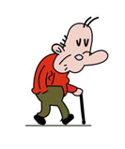
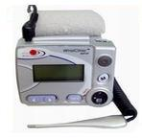
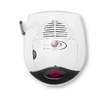

Use Case/ 1st Part
GP
Cont Creator/
Cont Consumer/
Tele-homecare Center
Cont Creator/
Cont Consumer/
Device Obs. Reporter/
Device Osv. Consumero
Patient home
Biomedical devices
Gateway
Device Obs Reporter
[PCD-01]
Communicate PCD Data
System for data storage and management
EHR
[PCD-01]
Communicate PCD Data
[ITI-43]
Retrieve Doc Set
[ITI-41] Provide&Register
Doc Set-b (TWD)
[ITI-41]
Provide&Register Doc Set-b (TWD + TRD)
Repository
Telemonitoring data collection
Repository
[ITI-43]
Retrieve Doc Set
Hospital’s Specialist
Cont Creator/
Cont Consumer/
[ITI-42]
Register Doc Set-b
2nd Phase: periodic data transmission process
[ITI-18]
Registry Stored Query
1st Phase:
TWD Creation
EHR
Community
Infrastructure
[ITI-42]
Register Doc Set-b
Registry
[ITI-18]
Registry Stored Query
Repository

Slide 6
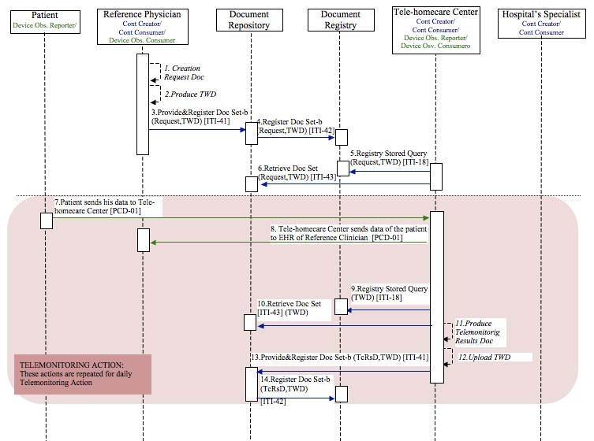
Use Case/ 1st Part

Slide 7
Use Case/ 2nd Part
In the case that the data sent by the patient go out the threshold, the Tele-homecare Center alerts the reference physician (GP), creating a Request Consult Document (RCD) referenced in TWD, that analyzes the data of the patient and if he decides that patient needs to have a specialist visit, creates the eReferral Document, referenced in the same Workflow Document, for the visit order.
When the visit takes place, the specialist, may consult the Workflow Document to have the complete clinical history of the telemonitored patient and he can update it based on the visit outcomes.

Slide 8
Use Case/ 2nd Part
GP
Cont Creator/
Cont Consumer/
Device Osv. Consumer
Tele-homecare Center
Cont Creator/
Cont Consumer/
Device Obs. Reporter/
Device Osv. Consumer
Patient home
Biomedical devices
Gateway
Device Obs Reporter
[PCD-01]
Communicate PCD Data
System for data storage and management
EHR
[ITI-41]
Provide&Register Doc Set-b
(TWD + TRD + RCD)
[ITI-41] Provide&Register
Doc Set-b
(TWD + eReferral Doc)
Telemonitoring data collection
[PCD-01]
Communicate PCD Data
Repository
Repository
[ITI-43]
Retrieve Doc Set
Hospital’s Specialist
Cont Creator/
Cont Consumer/
[ITI-43]
Retrieve Doc Set
[ITI-42]
Register Doc Set-b
[ITI-18]
Registry Stored Query
EHR
Community
Infrastructure
Legend:
TWD: Telemonitoring Workflow Document
TRD: Telemonitoring Results Document
RCD: Request Consult Document
Registry
[ITI-41] Provide&Register
Doc Set-b
(TWD + Report Doc)
Repository
[ITI-42]
Register Doc Set-b

Slide 9
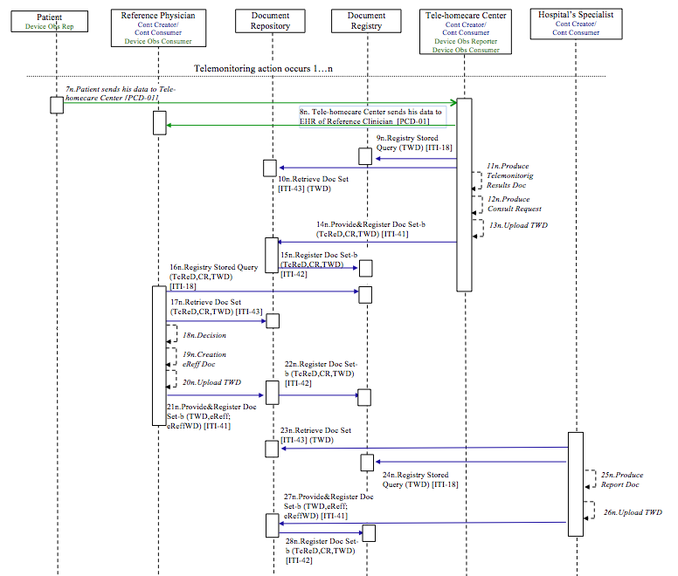
Use Case/ 2nd Part

Slide 10
Proposed Standards & Systems
Afferent IHE Domains: IT Infrastructure, Patient Care Coordination
Afferent IHE Profiles – Existing: DEC (Device Enterprise Communication), ACM (Alarm Communication Management), IDCO (Implantable Device Cardiac Observation), RTM (Rosetta Terminology Mapping), ITI – XDW, ITI – XDS.b
XDW does not introduce new actors and transactions
No XDS Metadata extension expected, but specific rules about metadata content for the Workflow Document

Slide 11
Discussion
The work effort for profiling the XTHM-WD will be focused on the definition of:
  the workflow definition for the management of a telemonitoring process, including all clinical events and tracking their status and their related documents, allowing all actors involved to share and contribute to the same cross-enterprise document workflow (ITI Domain);
  the integration of clinical data measured by the patient into information systems of different enterprises (PCD Domain).
Profile editors:
  Silvia Mancin, Arsenàl.IT, smancin@consorzioarsenal.it
  Valentina Ferrarini, Arsenàl.IT, vferrarini@consorzioarsenal.it
  Arianna Cocchiglia. Arsenàl.IT, acocchiglia@consorzioarsenal.it
  Luca Zalunardo, Arsenàl.IT, lzalunardo@consorzioarsenal.it
  Organization: Arsenal.IT, www.consorzioarsenal.it

